Slide 1
Bylaws for ND PTA Units
Presented by Cheryl Simmons
NDPTA Bylaws Chair
January 26, 2022

Slide 2
Agenda:
Model Bylaws Template
Best practices for local units
Q&A Time

Slide 3
Where to find the Model Bylaws?
MemberHub in Communications-Files & Photos-Bylaws
https://ndpta.memberhub.com/public/uploads/09db77f0-32e8-4c3b-841d-67ee1cbadd57
NDPTA.org website under Unit ToolsBox – Resources Page
RESOURCES | North Dakota PTA (ndpta.org)
Send email to NDPTA@gmail.com

Slide 4
Article I - Name
The name of this association is the _Unit Name __ Parents and Teacher Association (PTA), _City___, North Dakota. It is a PTA organized under the authority of North Dakota Congress of Parents and Teachers (NDPTA), a branch of National Congress of Parents and Teachers (National PTA).
Notes:
Fill in the blanks

Slide 5
Article II - Purposes
Section 1. The purposes of the PTA are
To promote the welfare of children and youth in home, school, places of worship and throughout the community;
To raise the standards of home life;
To advocate for laws that further the education, physical and mental health, welfare, and safety of children and youth;
To promote the collaboration and engagement of families and educators in the education of children and youth;
To engage the public in united efforts to secure the physical, mental, emotional, spiritual and social well-being of all children and youth; and
To advocate for fiscal responsibility regarding public tax dollars in public education funding.
Section 2. The purposes of the PTA are promoted through an advocacy and education in collaboration with parents, families, teachers, educators, students, and the public; developed through conferences, committees, projects, and programs; and governed and qualified by the basic principles set forth in Article III.
Section 3. The association is organized exclusively for the charitable, scientific, literary, or educational purposes within the meaning of Section 501(c)(3) of the Internal Revenue Code or corresponding section of any future federal tax code (hereinafter referred to as “Internal Revenue Code”).
Notes:
Copy – these are the same as the National PTA bylaws and need to exist in all units bylaws.

Slide 6
Article III – Basic Principles
The following are basic principles of National PTA:
The association shall be noncommercial, nonsectarian, and nonpartisan.
The association shall work to engage and empower children, families, and educators within schools and communities to provide quality education for all children and youth, and shall seek to participate in the decision-making process by influencing school policy and advocating for children’s issues, recognizing that the legal responsibility to make decisions has been delegated by the people to boards of education, state education authorities, and local education authorities.
The association shall work to promote the health and welfare of children and youth, and shall seek to promote collaboration between families, schools, and the community at large.
Commitment to inclusiveness and equity, knowledge of PTA, and professional expertise shall be guiding principles for service in this PTA.
Notes:
Fill in the blanks

Slide 7
Article IV – Relationship with National PTA and North Dakota PTA
Section 1. This PTA shall be organized and chartered under the authority of the North Dakota PTA in the area in which this PTA functions, in conformity with such rules and regulations, not in conflict with the National PTA bylaws, as the North Dakota PTA may in its bylaws prescribe. The North Dakota PTA shall issue to this PTA an appropriate charter evidencing the due organization and good standing of this PTA.
A PTA in good standing is one that
Adheres to the purposes and basic policies of the PTA;
Remits the national and state portion of the dues to the state PTA office by dates designated by North Dakota PTA;
Has bylaws for the government of the association that conform to and are approved by the North Dakota PTA according to the state procedures; and
Meets other criteria as prescribed by North Dakota PTA.
Section 2. Bylaws of this PTA shall include an article on amendments.
Section 3. Bylaws of this PTA shall include a provision establishing a quorum.
Section 4. Each officer or board member of this PTA shall be a member of this PTA.
Section 5. The bylaws of this PTA shall prohibit voting by proxy
Section 6. This Local PTA is obligated, upon the withdrawal of its charter by North Dakota PTA, and after paying or adequately providing for the debts and obligations of the association:
To turn over the remaining assets and all of its books and records to North Dakota PTA;
To cease and desist from the further use of any name that implies or connotes association with the National PTA or the North Dakota PTA or status as a constituent association of the National PTA;
To carry out promptly, under the supervision and direction of the North Dakota PTA, all proceedings necessary or desirable for the purpose of dissolving such local PTA.
Notes:
Fill in the blanks

Slide 8
Article V-Membership and Dues
Section 1. Every individual who is a member of this PTA is, by virtue of that fact, a member of the National PTA and of the North Dakota PTA by which this PTA is chartered, and is entitled to all the benefits of such membership.
Section 2. Each member of this PTA shall pay annual dues to said association. The amount of such annual dues shall include the portion payable to the North Dakota PTA and the portion payable to National PTA.
Section 3. Membership in PTA shall be open, without discrimination, to anyone who believes in and supports the mission and purpose of National PTA.
Section 4 Only members of __Unit Name___ PTA who have paid dues for the current membership year may participate in the business, including voting, at the __Unit Name __ PTA.
Section 5. Only members of this Local PTA may serve in any elective or appointive position.

Slide 9
Article VI - Officers
Section 1. The officers of this PTA shall be a president, a vice president, a secretary, and a treasurer.
Section 2. Officers shall be elected in the month of [insert name of month this is usually May].
Section 3. The vote shall be conducted by ballot and a majority vote shall elect. When there is only one candidate for any office that election may be held by voice vote.
Section 4. The following provisions shall govern the eligibility of individuals to be officers of the _Unit Name __ PTA:
a. Each officer shall be a member of this PTA.
b. No officer may be eligible to serve more than [number] consecutive terms in the same office.
c. A person who has served in an office for more than one half of a full term shall be deemed to have served a full term in such office.

Slide 10
Article VI - Officers
Section 5. Officers shall assume their official duties following the close of the meeting in [insert name of month usually May] and shall serve for a term of [number] year(s) or until their successors are elected.
Section 6. A vacancy occurring in the office of president shall be filled for the remainder of the unexpired term by the vice president. A vacancy in any office other than president shall be filled by a majority vote of the executive board with at least three (3) days’ notice of such election having been given.
Section 7. There shall be a nominating committee composed of [insert an odd number, no less than three] members who shall be elected by this PTA at a regular general membership meeting at least one (1) month prior to the month in which election of officers is held, as outlined in Article VI, Section 2.
The committee shall elect its chair.
The nominating committee shall nominate an eligible person for each office to be filled and report its nominees at the regular general membership meeting in [insert month of elections usually May], at which time additional nominations may be made from the floor. The report shall be publicized to the Local PTA membership at least seven (7) days before the meeting when elections occur.
Only those individuals who are current members of this PTA and who have signified their consent to serve if elected shall be nominated for, or elected to, such office.

Slide 11
Article VII – Duties of Officers
Section 1. The president shall
Preside at all meetings of this PTA;
Confirm that a quorum is present before conducting any business at any meeting of the association;
Serve as an ex officio member of all committees except the nominating committee;
Coordinate the work of the officers and committees of this PTA in order that the purposes may be promoted;
Be authorized to sign contracts that have been approved by the executive board.
Send the names and contact information of the officers to the North Dakota PTA by May 15th of each year;
Be listed as the principal officer and be authorized to sign tax documents;
Direct the treasurer to complete and file all necessary tax documents;
Perform such other duties as may be provided for by these bylaws, prescribed by the parliamentary authority, or directed by the executive board.

Slide 12
Article VII – Duties of Officers
Section 2. The vice president shall
Act as aide to the president;
Perform the duties of the president in the president’s absence or inability to serve;
Perform such other duties as may be provided for by these bylaws, prescribed by the parliamentary authority, or directed by the president or the executive board.

Slide 13
Article VII – Duties of Officers
Section 3. The secretary shall
Record the minutes of all meetings of the __Unit Name __ PTA;
Be prepared to read the records of any previous meetings;
File all records;
Have a current copy of the bylaws;
Maintain a membership list which shall not be released to outside interests;
Perform such other duties as may be provided for by these bylaws, prescribed by the parliamentary authority, or directed by the president or the executive board.

Slide 14
Article VII – Duties of Officers
Section 4. The treasurer shall
Have custody of the funds of this PTA;
Keep full and accurate accounts and records of the funds of this PTA as shall be sufficient to establish the items of gross income receipts and disbursements including bank statements, receipts, budgets, invoices paid, paid receipts and canceled checks in accordance with the record retention policy. This also includes specifically the number of its members, the dues collected from its members and the amount of dues remitted to North Dakota PTA;
Make disbursements as authorized by the president, executive board, or this PTA in accordance with the budget adopted by this PTA;
Bank accounts need to be reconciled monthly by two people: the treasurer and [designated person] or President
Provide a written financial statement at each meeting;
Present an annual report of the financial condition of the organization;
Submit the books annually for a financial review at the close of the PTA’s fiscal year. The review should be completed before the first executive board meeting of the next fiscal year. The review should be conducted by a financial review committee or auditor selected by the executive board. None of the signatories (authorized signers) on the PTA’s accounts (for the fiscal year being reviewed) can be on the review committee. The treasurer shall be available to answer any questions that arise;
Report the findings of the annual financial review to the executive board;
Complete and file all necessary tax documents as directed by the president;
Perform such other duties as may be provided for by these bylaws, prescribed by the parliamentary authority, or directed by the president or the executive board.

Slide 15
Article VIII – Executive Board
Section 1. The members of the executive board shall be
Elected officers;
Principal of the school or the principal’s representative appointed by the principal;
[This is optional but you may include the chairs of standing committees; if so list the specific ones for your PTA; and
[This is optional but you may include and list as applicable to the PTA, i.e., special committee chairs, teacher representatives, student representatives, etc.]
The president may appoint a parliamentarian, subject to approval of the executive board of this PTA.
Section 2. Duties of the executive board shall be to
Carry out business in the intervals between general membership meetings and such other business as may be referred to it by the membership of the association;
Present a report at the regular general membership meetings of this PTA;
Create standing and special committees;
Approve the plan of work of the committees;
Prepare and submit an annual budget to this PTA’s general membership for adoption;
Approve payment of routine bills within the limits of the approved budget;
Fill vacancies of officers and chairs;

Slide 16
Article VIII – Executive Board
Section 3. If any member of the executive board shall at any time cease to meet the qualifications or fulfill the duties of the position, that person may be removed from the board by resolution adopted by the executive board.
Section 4. Regular meetings of the executive board shall be held with the date and time to be fixed by the board at its first meeting of the year.
Section 5. Special meetings of the executive board may be called by the president or when requested by three (3) members upon three (3) days’ notice to each member of the board. Special meetings or votes may be held via phone or electronically if all members have access to such technology. Any vote occurring at meetings held electronically must be placed on the agenda at the following regular meeting.
Section 6. At all meetings of the executive board, a majority of the members of the board shall constitute a quorum for the transaction of business.
Section 7. Upon the expiration of the term of office or when individuals cease to hold the position that entitles them to be a member of the executive board, they shall automatically cease to be a member of the board and shall be relieved of all duties and responsibilities incident to such membership. All records, books, and other materials pertaining to the position shall be turned over to the president and all funds pertaining to the position shall be returned to the treasurer within 14 days.

Slide 17
Article IX - Committees
Section 1. Only members of this PTA shall be eligible to serve in any elective or appointive positions.
Section 2. The standing committees of this PTA shall be
[List your school’s committees, i.e. health/welfare, legislative, Reflections, student enrichment, fall family night, etc.].
Section 3. The executive board may create such special committees, as it may deem necessary to promote the purposes of PTA and carry on the work of this PTA.
Section 4. The term of office of a committee chair shall be [number] year(s) or until the selection of a successor.
Section 5. The chair of each committee shall present a plan of work to the executive board for approval. No committee work shall be undertaken without the consent of the executive board.

Slide 18
Article X – General Membership Meetings
Section 1. This association shall hold a minimum of five (5) regular membership meetings a year.
Regular membership meetings of this PTA shall be held at the dates and times to be determined by the executive board at their first meeting of the year. Members shall be notified of the dates and times of regular membership meetings following the executive boards first meeting. Three (3) days’ notice shall be given to the membership of any change of date.
The regular membership meeting in [month – usually May] shall be the election meeting.
The annual meeting in [month of last meeting of year – usually May] shall be for the purpose of receiving reports from officers and chairs and for any other necessary business.
Section 2. Special meetings of this PTA may be called by the president or by a majority of the executive board, three (3) days’ notice having been given.
Section 3. [Number – minimum of five (5)] members shall constitute a quorum for the transaction of business in any general membership meeting of this PTA.
Notes:
Fill in the blanks

Slide 19
Article XI – NDPTA Annual Meeting/Convention
Section 1. This PTA shall be represented at the annual meeting of the North Dakota PTA by the president, or appointed alternate, and by delegate(s) or alternates. All representatives to the North Dakota PTA Annual Meeting/Convention must be members of this PTA.
Delegates and their alternates shall be [elected by the membership, elected by the executive board or appointed, subject to the approval of the executive board. Choose one or more options from those listed.] no later than the month prior to the Annual Meeting/Convention.
The number of delegates is based on the number of members recorded with the North Dakota PTA office as of March. One delegate is allowed per 25 members or majority thereof.

Slide 20
Article XII – Fiscal Year
The fiscal year of the (Unit name) PTA shall begin on July 1 and end on the following June 30.

Slide 21
Article XIII – Operational Requirements and Dissolution
Section 1. No part of the net earnings of the association shall inure to the benefit of, or be distributable to, its members, directors, trustees, officers, or other private persons except that the association shall be authorized and empowered to pay reasonable compensation for services rendered and to make payments and distributions in furtherance of the purposes set forth in Article II hereof.
Section 2. Notwithstanding any other provision of these articles, the association shall not carry on any other activities not permitted to be carried on (i) by an organization exempt from federal income tax under Section 501(c)(3) of the Internal Revenue Code or (ii) by an association, contributions to which are deductible under Section 170(c)(2) of the Internal Revenue Code.
Section 3. The association or members in their official capacities shall not, directly or indirectly, participate or intervene (in any way, including the publishing or distributing of statements) in any political campaign on behalf of, or in opposition to, any candidate for public office; or devote more than an insubstantial part of its activities to attempting to influence legislation by propaganda or otherwise.
Section 4. Upon the dissolution of this association, after paying or adequately providing for the debts and obligations of the association; the remaining assets and all of its books and records shall be surrendered to the North Dakota PTA.

Slide 22
Article XIV – Parliamentary Authority
The rules contained in the current edition of Robert’s Rules of Order, Newly Revised shall govern (Unit name) PTA in all cases in which they are applicable and in which they are not in conflict with National PTA Bylaws, the North Dakota PTA Bylaws, special rules of order or Articles of Incorporation.

Slide 23
Article XV – Electronic Meetings and Communications
Section 1. The __Unit Name__ PTA Executive Board and all committees and sub committees shall be authorized to meet by telephone conference or through other electronic
communications media so long as all members can simulataneously hear each other and participate during the meeting.
Section 2. Unless members indicate otherwise to __Unit Name__ PTA all communication required by these bylaws, including meeting notices, may be sent electronically unless otherwise specified in the bylaws.

Slide 24
Article XVII - Amendments
Section 1.
These bylaws may be amended at any general membership meeting, provided a quorum is present, by two-thirds (2/3) vote of the members present and voting. Notice of each proposed amendment shall be provided to the membership thirty (30) days prior to the meeting at which the amendment is voted upon or at the previous regular meeting. The amendment shall be subject to approval of the North Dakota PTA.
A committee may be appointed to submit a revised set of bylaws as a substitute for the existing bylaws only by a majority vote at a general membership meeting, or by a two-thirds (2/3) vote of the executive board. The procedure for action on amendments in Section 1.a. should then be followed.
After adoption by a two-thirds (2/3) vote at a meeting of the association, the bylaws and standing rules shall be submitted for approval to North Dakota PTA according to the policies and procedures of North Dakota PTA.
A revision of the bylaws or any amendments shall go into effect when an approved copy is returned by the North Dakota PTA.
Section 2. This Local PTA shall submit a set of bylaws to the North Dakota PTA for review every three (3) years.
Section 3. The adoption of an amendment to any provision of the bylaws by the North Dakota PTA shall serve automatically and without the requirement of further action by the Local PTA to amend its corresponding bylaws.

Slide 25
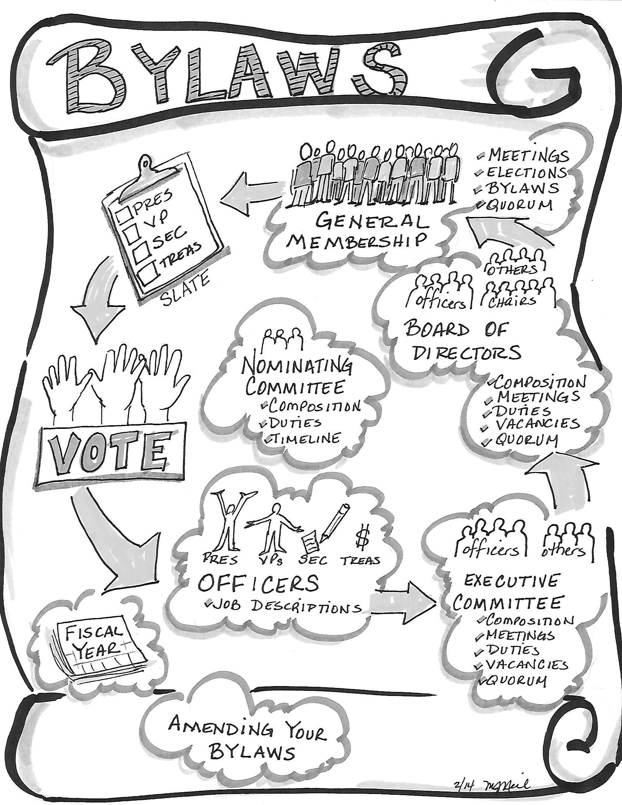

Slide 26
Questions?

Slide 27
Bylaws for ND PTA Units
Thank you for attending!

